Slide 1
Machine Learning Regression Models for Predicting Hemolytic Concentration (HC₅₀) of Peptides Using Curated Activity Data
Guide: Prof. G.P.S Raghava By: Ayushi Singh (MT23242) Department of Computational Biology, IIIT-Delhi

Slide 2
Part 1:
Hemolytik 2.0 – Compiling Hemolytic activity of peptides for database

Slide 3
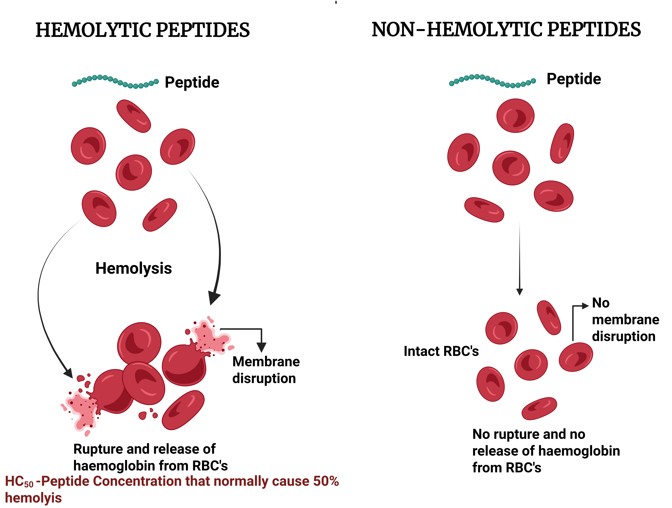
Introduction
Mechanism of action of Hemolytic and Non-Hemolytic peptides
Peptides are crucial in modern drug discovery.
Benefits: specificity, efficacy, low toxicity.
Key issue: Hemolytic toxicity – damage to red blood cells.
Need for reliable prediction models and curated data.

Slide 4
Objectives
Curate a comprehensive dataset of hemolytic & non-hemolytic peptides(HEMOLYTIK 2.0)
Majorly analyze hemolytic activity
Use this analysis for developing regression models that can predict HC₅₀ — the hemolytic potential of peptides

Slide 5
Hemolytik 2.0- Database Overview
Data Sources: PubMed, APD3, UniProt, CAMP-R4, DAMPD
Filtering: Manual curation of ~5000 articles (2013–2024)
Total Entries: 13,215 peptides (9,589 hemolytic, 3,626 non-hemolytic)
Distinct Sequences: ~8,000
Information stored: sequence, origin, hemolytic activity(HC₅₀ -1780), SMILES

Slide 6
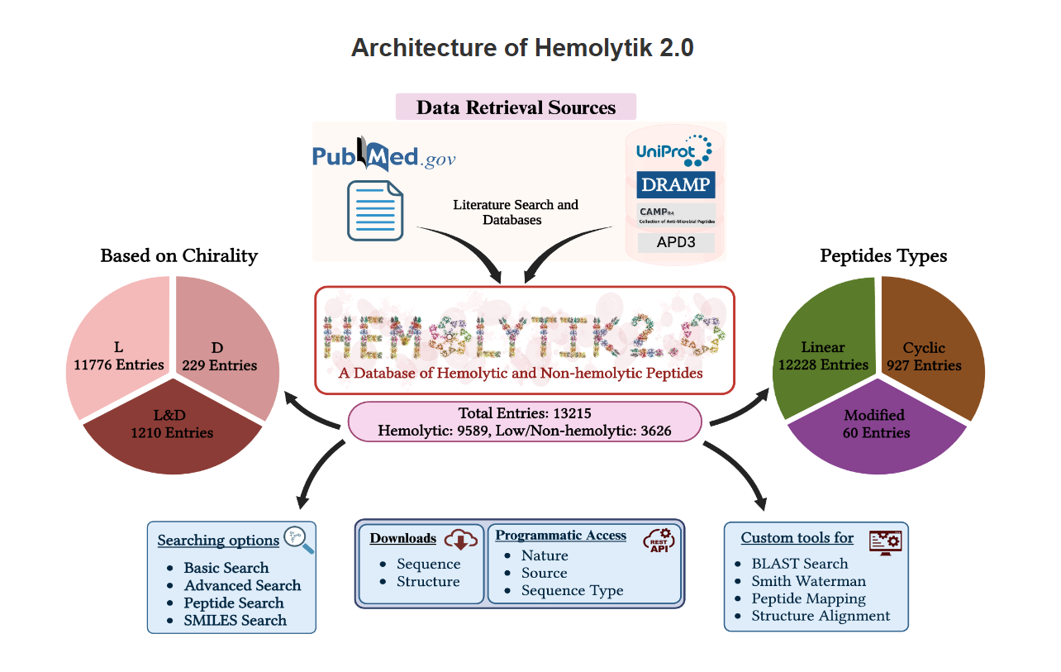
Data Architecture
[Frontend ↔ PHP ↔ MySQL ↔ Dataset]
Backend: MySQL + Apache
Frontend: HTML, CSS, JS, PHP
Exportable: PDB structures, aligned sequences, publication links

Slide 7
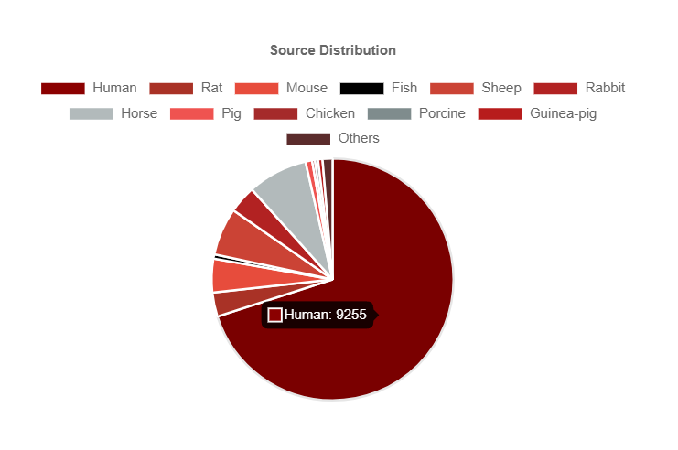



Data Statistics
13215 peptides categorized- 9589 hemolytic, 3626 non-hemolytic
20 RBC sources used ([Human, Horse, sheep]-top…)
Functional Categories: Antimicrobial, Anticancer, etc.
Chemical Modifications: D-AA, terminal groups, SMILES

Slide 8
Hemolytik 2.0 – Key tools and features
Annotations: Structure (cyclic/linear), terminal modifications, stereochemistry
Search Tools: Basic, Advanced, Peptide, SMILES
Analysis Tools: BLAST, Smith-Waterman, Mapping, Structure Alignment
Integration: RESTful API, SMILES, 3D structures

Slide 9
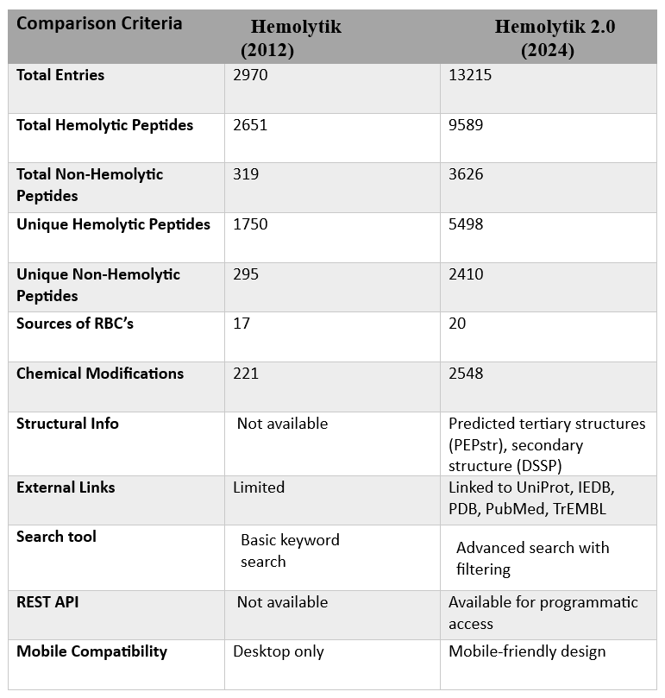
Hemolytik v/s Hemolytik2.0

Slide 10
Part 2:
HC₅₀ value Prediction – Regression Modelling

Slide 11
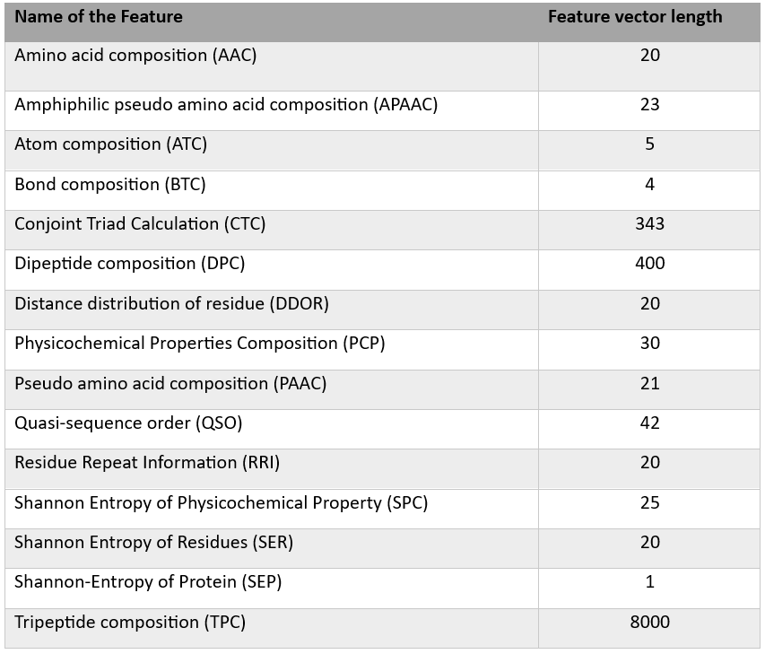
Feature Extraction
Total features: 8974 using Pfeature tool
Types: AAC, DPC, PCP, CTC, RRI, DDOR, ATC, BTC, etc.-15 features(1162 descriptors)
Captures structural, sequence, and physicochemical properties

Slide 12
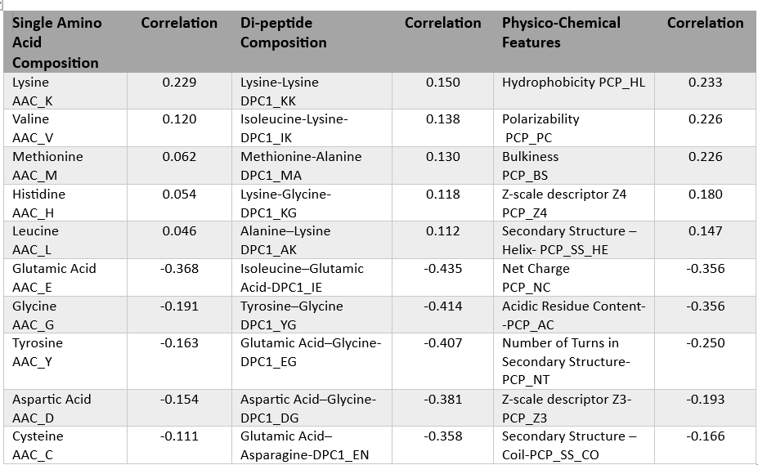
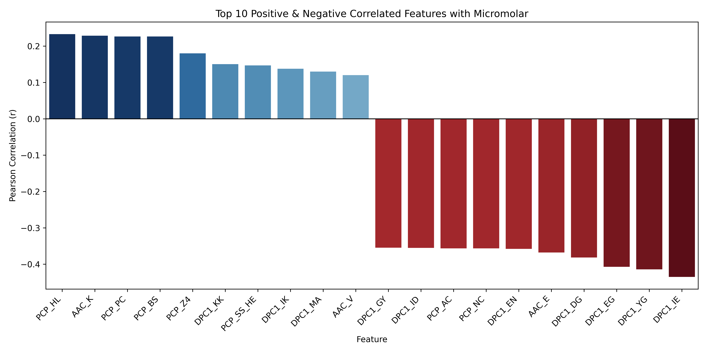
Correlation Analysis
Positive/negative features linked to hemolytic activity
Top Correlated Features: Charge, polarity, hydrophobicity

Slide 13
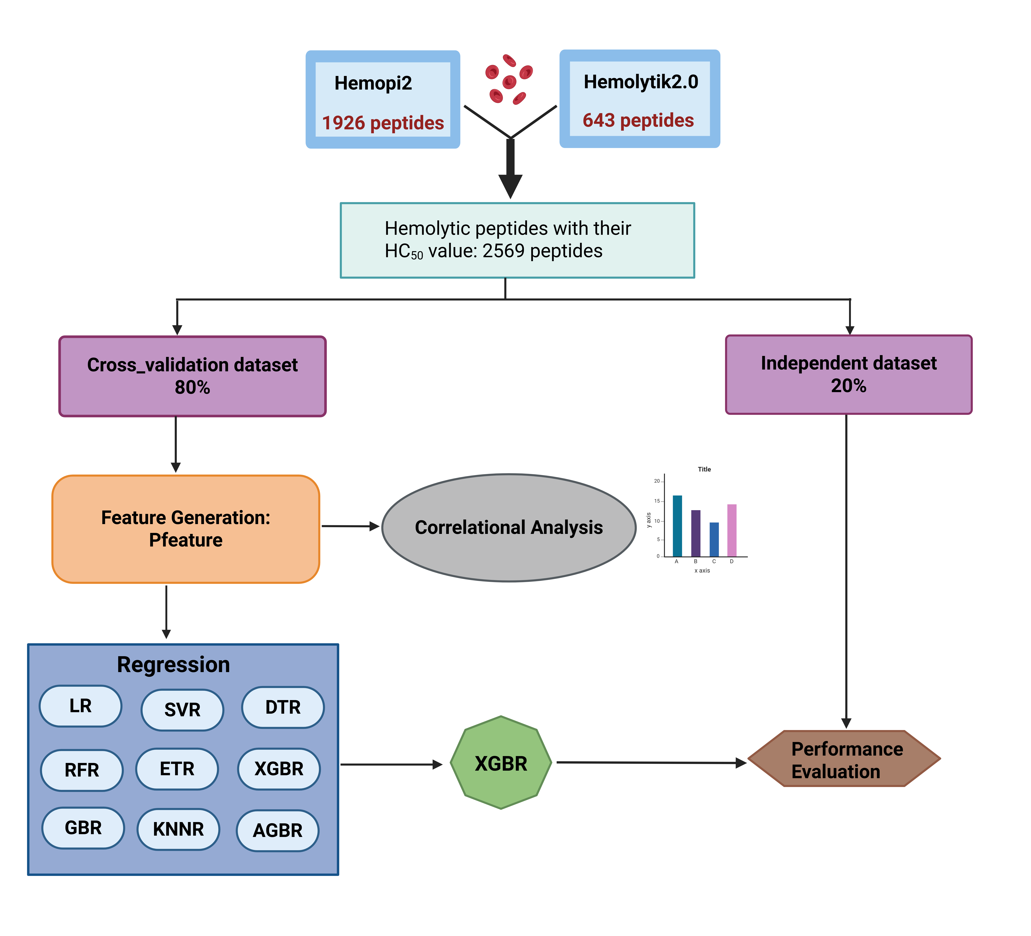
Model Architecture
Dataset: 2,569 peptides (HemoPi2 + Hemolytik2.0)
Filtering: Removed outliers, unified length
Model Target: Regression on pHC50 = log₁₀(HC₅₀)
Split: 80% Cross-validation, 20% Independent Test
Cross-validation: 5-fold approach
Models Used: SVR, ETR, RFR, DTR,LR, KNNR, etc.
Evaluation: R, MAE, MSE, R² on cross-valid & independent set
Output: Predicted hemolytic concentration (pHC₅₀)

Slide 14
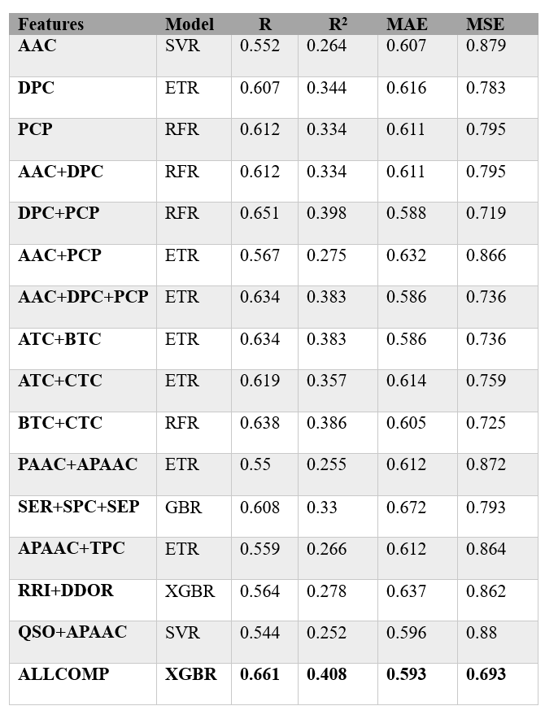
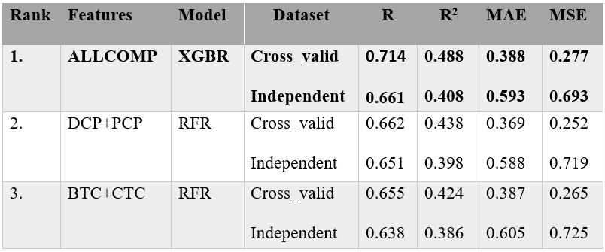
Regression Results
BEST MODEL: XGBR
R² = 0.408
Pearson R = 0.660
Moderate predictive capability
Top 3 performers

Slide 15
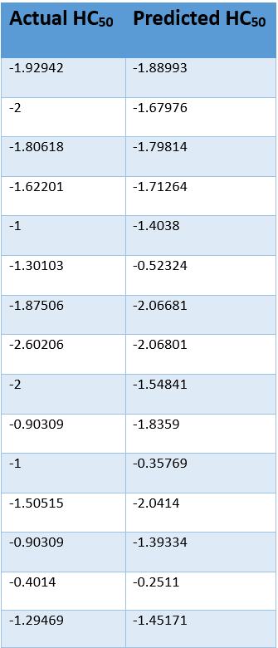
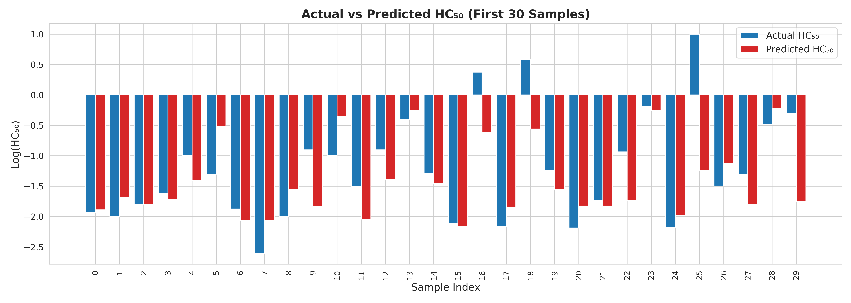
Results
The model's predictions are mostly close to the actual values.
This means the model is working well in most cases.
A few values are different, showing where the model can be improved.
Overall, the model can predict HC₅₀ fairly accurately.

Slide 16
Conclusion
Curated dataset of peptides with experimentally validated HC₅₀ values was used to train regression models.
Multiple machine learning algorithms were explored, with XGBoost and Random Forest showing strong predictive performance.
Feature engineering and log transformation improved model stability and accuracy.
Predicted HC₅₀ values aligned well with actual values for most peptides, indicating good generalization.
The study demonstrates the potential of ML models in estimating hemolytic concentration, supporting peptide drug design and toxicity prediction.

Slide 17
Future Work
Include more peptide sequences and HC₅₀ values from diverse sources to improve model robustness.
Using deep learning or embedding-based features (e.g., ProtBert)
Deploying a public web server for prediction

Slide 18
Questions?
Thankyou

